Slide 1

Applied Text Analytics ( F21AA ) Heriot Watt University , Dubai Campus
Dr. Neamat El Gayar

Slide 2
Recap from last lecture
Topic modelling, an unsupervised machine learning technique for abstracting topics from collections of documents.
Topics can also be referred to : concepts, themes, genre ,
Clustering vrs Topic Modelling:
Clustering seeks to establish groups of documents within a corpus
Python Implementations (Movie Review Case study)
Notes:
Riochi

Slide 3
Topics for this week
Overview on:
Text Analytics Pipeline & workflow
Sentiment Analysis
Cw1 and Cw2 expectations and outline
Case Study: SMS Spam case study

Slide 4
The Scikit-Learn API
Provides an implementation of a wide selection of model families into a friendly user interface
Allows to simultaneously train a wide variety of models, evaluate and compare them, and then utilize the fitted model to make predictions on new data.
Easily to automate a prototyping and experimentation with reusing code

Slide 5
The Scikit-Learn API ( how it works)
It is object-oriented and describes a hierarchy of interfaces for different machine learning tasks.
The main interface is an Estimator
any object that can learn from data.
Estimator objects implement classifiers, regressors, or clustering algorithms.
They can also include a wide array of data manipulation, from dimensionality reduction to feature extraction

Slide 6
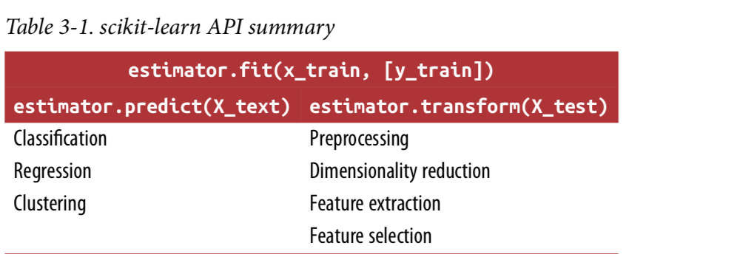
Use cases of the predict and transform methods in Scikit_learn
test)
To create a prediction in the form of a new output like y, you use the predict method.
To create a new representation of the input data X, you use the transform method.
Notes:
There are two main ways to apply a learned model in scikit-learn. To create a prediction in the form of a new output like y, you use the predict method. To create a new representation of the input data X, you use the transform method. Table 3-1 summarizes the use cases of the predict and transform methods.
Additionally, all supervised models have a score(X_test, y_test) method that allows an evaluation of the model. In Table 3-1, X_train and y_train refer to the training data and training labels, while X_test and y_test refer to the test data and test labels (if applicable).

Slide 7
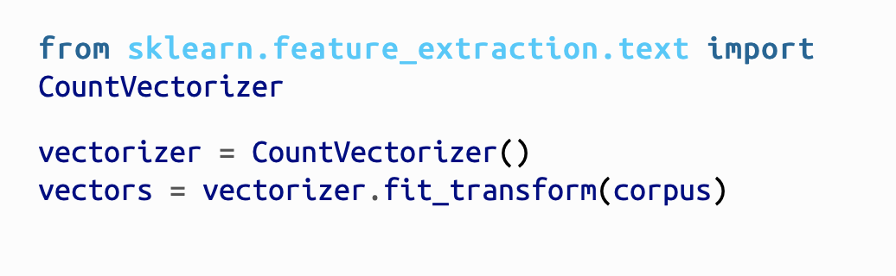
Recall from Lab2 (vectorization-transformers)
CountVectorizer ( Counting frequency of words)
When transform is called, each individual document is transformed into a sparse array whose index tuple is the row (the document ID) and the token ID from the dictionary, and whose value is the count

Slide 8
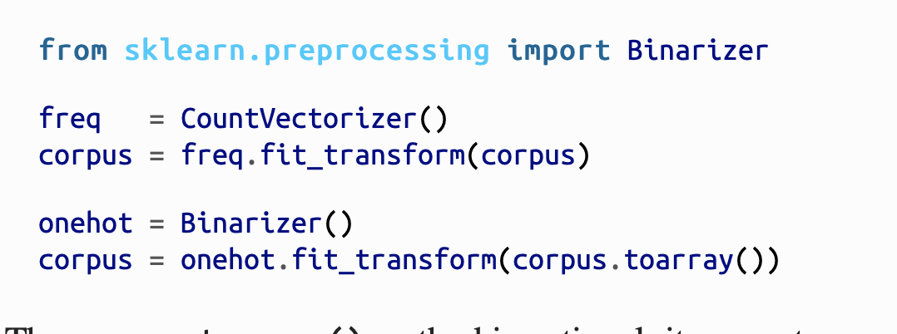
Recall from Lab2 (vectorization-transformers)
Binarizer ( Binary representation)
Converts all frequency values to 1 while maintaining the zero-valued frequencies.
corpus.toarray() method converts the sparse matrix representation to a dense one.
Use CountVectorizer(binary=True) to achieve binary representation
Notes:
he Binarizer class uses a threshold value (0 by default) such that all values of the vector that are less than or equal to the threshold are set to zero, while those that are greater than the threshold are set to 1”

Slide 9
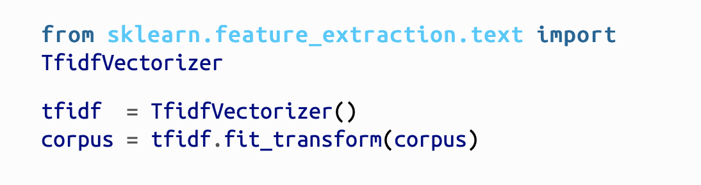
Recall from Lab2 (vectorization- transformers)
TfidfVectorizer
Implicitly uses the CountVectorizer to create bag-of-words representation to counting the occurrences of tokens, followed by a TfidfTransformer, which normalizes these occurrence counts by the inverse document frequency.
Notes:
“The input for a TfidfVectorizer is expected to be a sequence of filenames, file-like objects, or strings that contain a collection of raw documents, similar to that of the CountVectorizer.”
Excerpt From: Benjamin Bengfort, Rebecca Bilbro, Tony Ojeda. “Applied Text Analysis with Python.” Apple Books.

Slide 10
Scikit-learn vs. other NLP libraries
The scope and comprehensiveness of Scikit-Learn models and methodologies for machine learning make it an essential part of the modeling workflow.
Although both NLTK, Gensim, and even newer text analytics libraries like SpaCy have their own internal APIs and learning mechanisms
Possible to use the API to create our own Transformer and Estimator objects that implement methods from NLTK and Gensim.
For example, we can create topic modeling estimators that wrap Gensim’s LDA and LSA models (which are not currently included in Scikit-Learn) or create transformers that utilize NLTK’s part-of-speech tagging and named entity chunking methods.

Slide 11
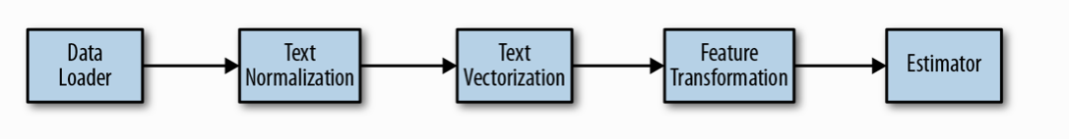
Pipelines in Scikit-learn
Chain together multiple estimators representing a fixed sequence of steps into a single unit.
All estimators in the pipeline, except the last one, must be transformers
The last estimator can be of any type, including predictive estimators.
Pipelines provide customization of text models by coupling a vectorization methodology with a predictive model.
Notes:
“The machine learning process often combines a series of transformers on raw data, transforming the dataset each step of the way until it is passed to the fit method of a final estimator.”
Excerpt From: Benjamin Bengfort, Rebecca Bilbro, Tony Ojeda. “Applied Text Analysis with Python.” Apple Books.

Slide 12
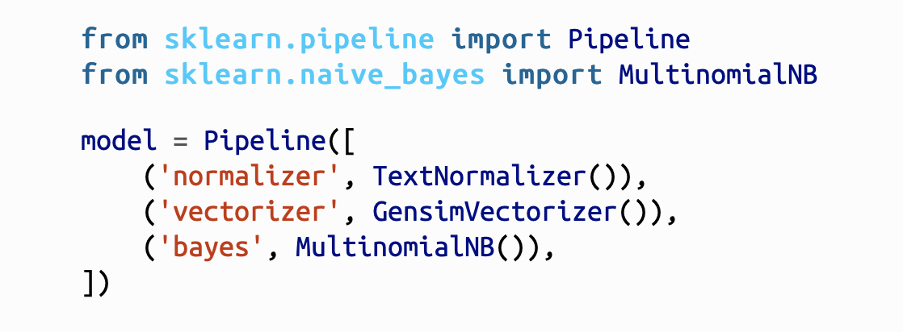
Pipelines in Scikit-learn (Example)
Pipelines are constructed by describing a list of (key, value) pairs where the key is a string that names the step and the value is the estimator object.
The Pipeline can then be used as a single instance of a complete model.
Calling model.fit is the same as calling fit on each estimator in sequence, transforming the input and passing it on to the next step.
model.steps[1]
Notes:
“Here is an example that joins the TextNormalizer and GensimVectorizer we created in the last section together in advance of a Bayesian model. By using the Transformer API as discussed earlier in the chapter, we can use TextNormalizer to wrap NLTK CorpusReader objects and perform preprocessing and linguistic feature extraction. Our GensimVectorizer is responsible for vectorization, and Scikit-Learn is responsible for the integration via Pipelines, utilities like cross-validation, and the many models we will use, from Naive Bayes to Logistic Regression.”
“The estimators in the pipeline are stored as a list, and can be accessed by index. For example, model.steps[1] returns the tuple ('vectorizer', GensimVectorizer​(path=None)). However, common usage is to identify estimators by their names using the named_steps dictionary property of the Pipeline object. The easiest way to access the predictive model is to use model.named_steps["bayes"] and fetch the estimator directly.”
Excerpt From: Benjamin Bengfort, Rebecca Bilbro, Tony Ojeda. “Applied Text Analysis with Python.” Apple Books.

Slide 13
Pipelines in Scikit-learn (Example)
The pipeline will have all the methods the last estimator in the pipeline has.
If the last estimator is a transformer, so too is the pipeline.
If the last estimator is a classifier, as in the example, then the pipeline will also have predict and score methods so that the entire model can be used as a classifier.
Notes:
“The estimators in the pipeline are stored as a list, and can be accessed by index. For example, model.steps[1] returns the tuple ('vectorizer', GensimVectorizer​(path=None)). However, common usage is to identify estimators by their names using the named_steps dictionary property of the Pipeline object. The easiest way to access the predictive model is to use model.named_steps["bayes"] and fetch the estimator directly.”
Excerpt From: Benjamin Bengfort, Rebecca Bilbro, Tony Ojeda. “Applied Text Analysis with Python.” Apple Books.

Slide 14
Grid search and pipelines
Grid search can be implemented to modify the parameters of all estimators in the Pipeline

Slide 15
Classification Workflow
Estimator objects, they can be employed in a procedural fashion and compared using cross-validation to select the best performing predictor.
Notes:
“The classification workflow occurs in two phases: a build phase and an operational phase as shown in Figure 5-2.”
“In the build phase, a corpus of documents is transformed into feature vectors. The “document features, along with their annotated labels (the category or class we want the model to learn), are then passed into a classification algorithm that defines its internal state along with the learned patterns. Once trained or fitted, a new document can be vectorized into the same space as the training data and passed to the predictive algorithm, which returns the assigned class label for the document.”
Excerpt From: Benjamin Bengfort, Rebecca Bilbro, Tony Ojeda. “Applied Text Analysis with Python.” Apple Books.

Slide 16
Classification Pipeline Example
Notes:
Example: “We can start with a pipeline that normalizes our text, vectorizes it, and then passes it directly into a classifier. This will allow us to compare different text classification models such as Naive Bayes, Logistic Regression, and Support Vector Machines. Finally, we can apply a feature reduction technique such as Singular Value “Decomposition to see if that improves our modeling.”
“The end result is that we’ll be constructing six classification models: one for each of the three models and for the two pipeline combinations as shown in Figure 5-5. We will go ahead and use the default hyperparameters for each of these models initially so that we can start getting results.”

Slide 17
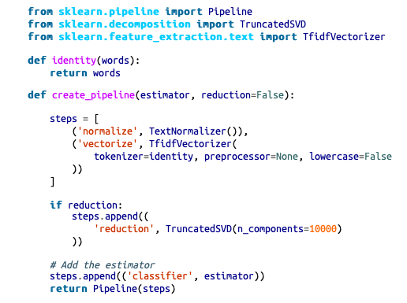
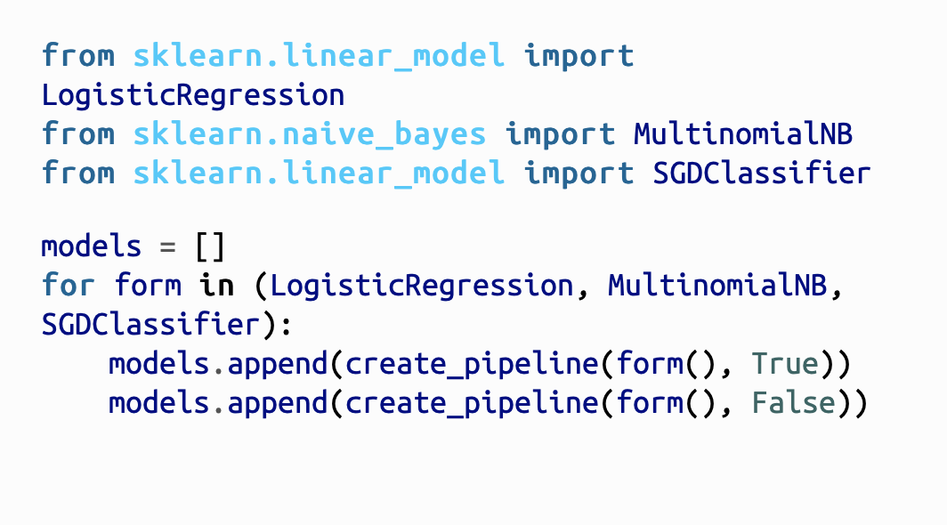
Classification Pipeline Example (defining model & workflow)
Generate models
Create the pipeline
Notes:
“ if reduction:
steps.append((
'reduction', TruncatedSVD(n_components=10000)
))
# Add the estimator
steps.append(('classifier', estimator))
return Pipeline(steps)”
Excerpt From: Benjamin Bengfort, Rebecca Bilbro, Tony Ojeda. “Applied Text Analysis with Python.” Apple Books.

Slide 18

Fitting the models given a training dataset of documents and their associated labels :
Classification Pipeline Example (training)
The models list now contains six model forms—instantiated pipelines that include specific vectorization and feature extraction methods (feature analysis), a specific algorithm, and specific hyperparameters (currently set to the Scikit-Learn defaults).
Notes:
“By calling the fit() method on each model, the documents and labels from the training dataset are sent into the beginning of each pipeline. ”
Excerpt From: Benjamin Bengfort, Rebecca Bilbro, Tony Ojeda. “Applied Text Analysis with Python.” Apple Books.

Slide 19
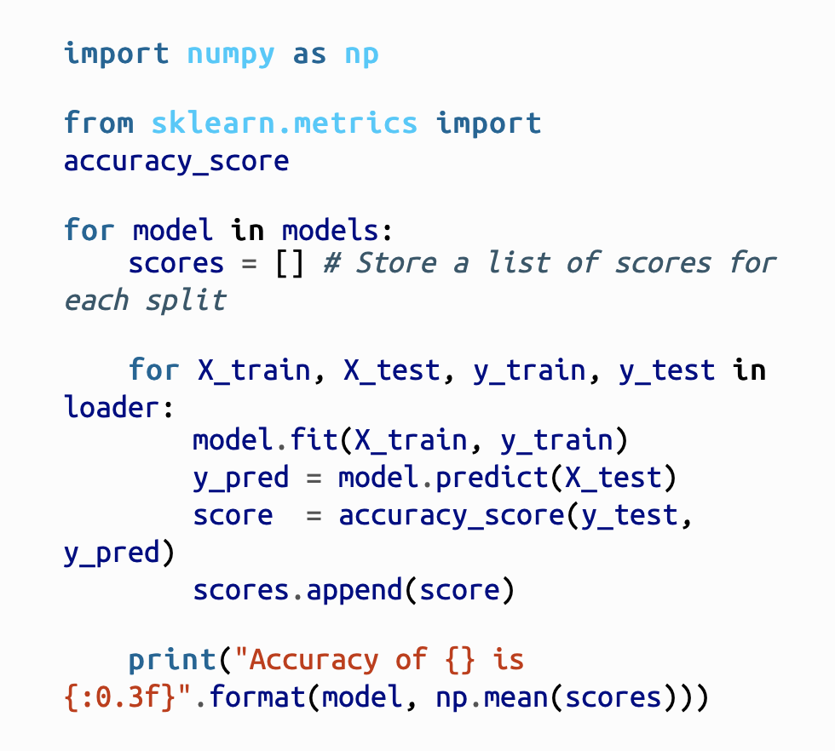
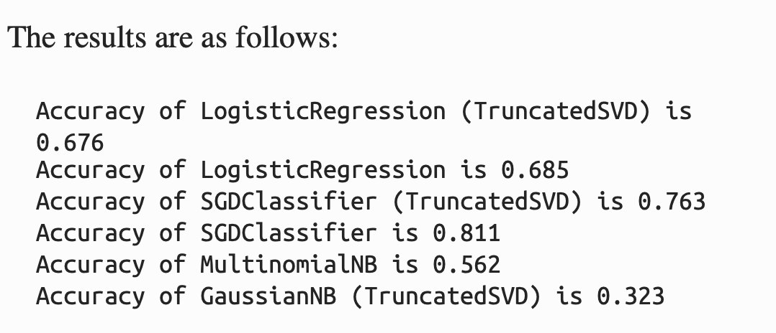
Classification Pipeline (Model Evaluation)
Get previously generated and stored folds train/test
Print mean for each train/test fold

Slide 20
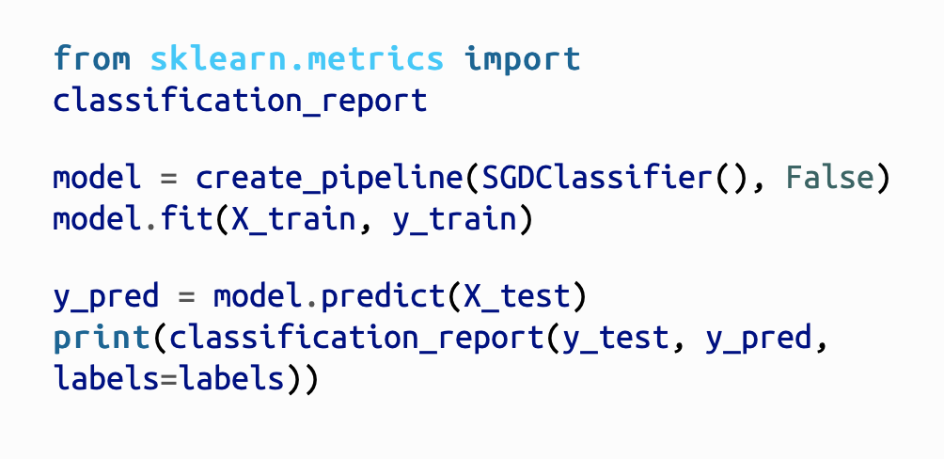
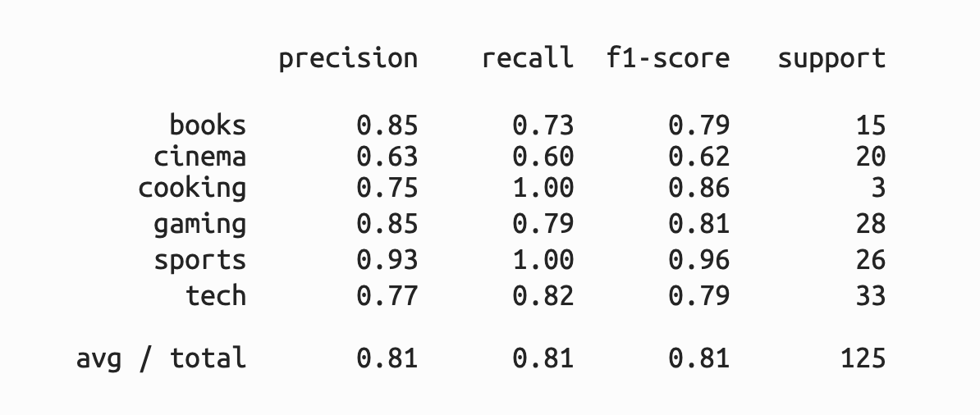
Classification Example (Classification Report)
Support shows how many test instances were used /class
Printing per-class breakdown of model performance
Here we have 6 classes for customer hobby/preferences

Slide 21
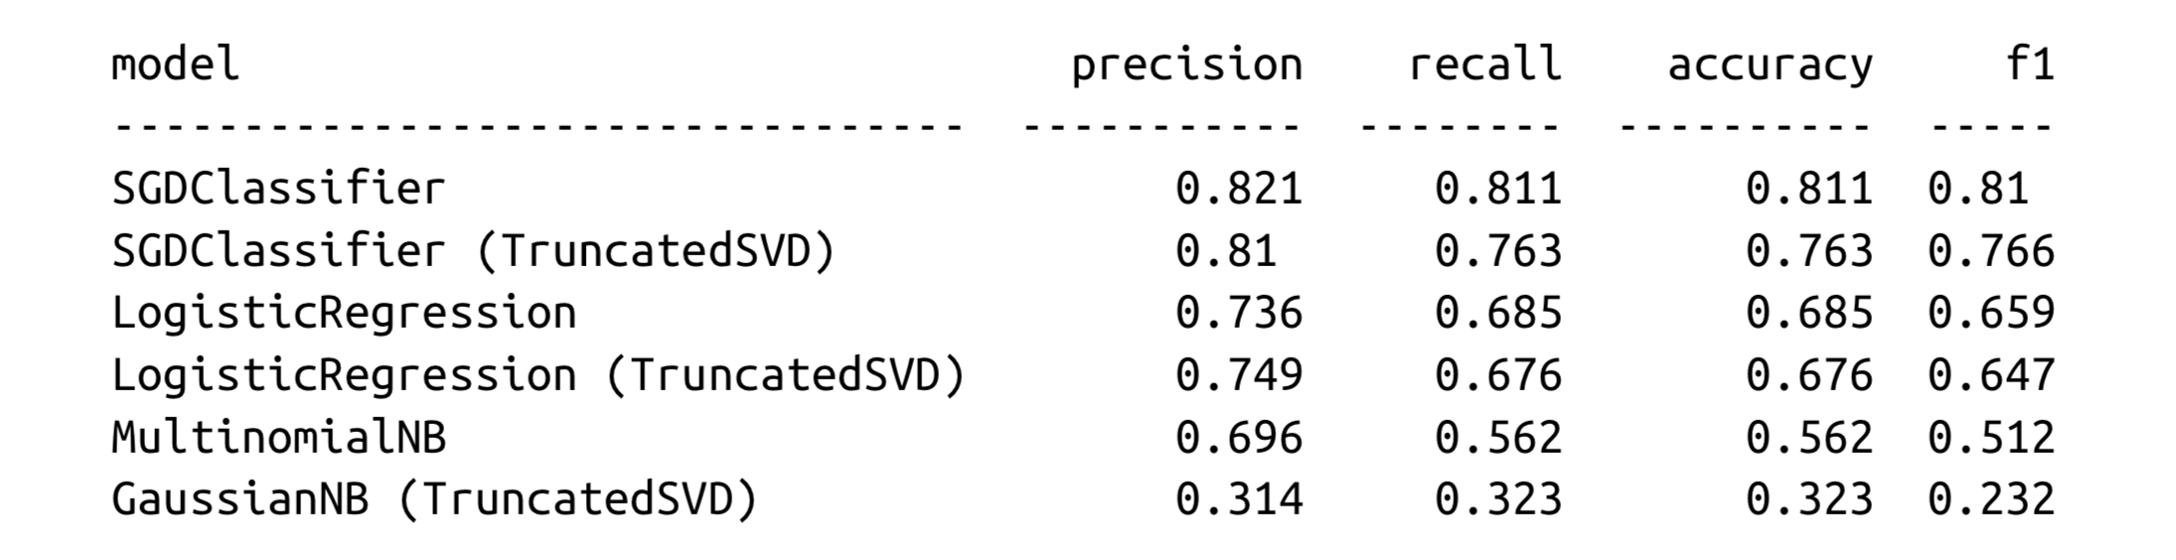
Classification Example (Model Comparison)
Through model comparison of this type, it becomes easy to test combinations of features, hyperparameters, and algorithms to find the best performing model for your domain.
Notes:
This allows us to quickly identify that the support vector machine trained using stochastic gradient descent without dimensionality reduction was the model that per‐ formed best. Note that for some models, like the LogisticRegression, use of the F1 score instead of accuracy has an impact on which model is selected. Through model comparison of this type, it becomes easy to test combinations of features, hyperparameters, and algorithms to find the best performing model for your domain.

Slide 22
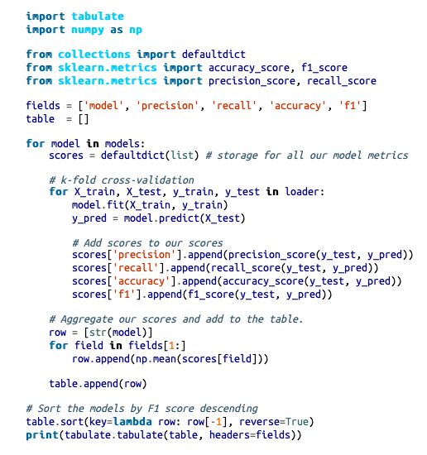
Classification Example (Model Comparison-code)
Notes:
This allows us to quickly identify that the support vector machine trained using stochastic gradient descent without dimensionality reduction was the model that per‐ formed best. Note that for some models, like the LogisticRegression, use of the F1 score instead of accuracy has an impact on which model is selected. Through model comparison of this type, it becomes easy to test combinations of features, hyperpara‐ meters, and algorithms to find the best performing model for your domain.

Slide 23
Classification Example (Model Comparison-code)
Creating the table headings
For each model store scores in dictionary
Each model is tested on pre-generated k folds
Creating a row of the table
First element in the raw is the model name
Add mean score from each fold to the table (field 1-4 are evaluation scores for each model )
Sort table to display best F1 score(last column -1)
Notes:
This allows us to quickly identify that the support vector machine trained using stochastic gradient descent without dimensionality reduction was the model that per‐ formed best. Note that for some models, like the LogisticRegression, use of the F1 score instead of accuracy has an impact on which model is selected. Through model comparison of this type, it becomes easy to test combinations of features, hyperpara‐ meters, and algorithms to find the best performing model for your domain.

Slide 24
Applied text analytics (common workflow)
Create a corpus
Select a vectorization technique
Fit a model, and evaluate using cross-validation.
Wash, rinse, repeat, and compare results.
At application time, select the model with the best result based on cross-validation and use it to make predictions.
Choose metrics such as precision, recall, accuracy, and F1 scores that can be used to guide our selection of algorithms.
Notes:
All End to End ML project checklist still apply ( just add the text specific modification related to pre-processing, classifier choice & evaluation)

Slide 25
Reference (Examples –p. 89-94)
Constructing a pipeline for:
Normalization
If-Idf (vectorization)
Fitting Logistic Regression, NB & SVM
Scoring & evaluating the classifiers based on accuracy, recall, F1,..etc in tabular form
Benjamin Bengfort, Rebecca Bilbro, Tony Ojeda. “Applied Text Analysis with Python.”

Slide 26
References
Benjamin Bengfort, Rebecca Bilbro, Tony Ojeda. “Applied Text Analysis with Python.
( Interesting pipelines)
Scikit-learn https://scikit-learn.org/stable/user_guide.html

Slide 27
Thank You

